Slide 1
Inferential Statistics
for
Data Science - 2

Slide 2
Outline
Intro to Hypothesis Testing
Principle of Hypothesis Testing
Null and Alternate Hypothesis
One-tailed Vs Two-tailed hypothesis test
Various Hypothesis tests:
Z-test
t-test
Chi-squared test
Types of errors in hypothesis tests

Slide 3
Hypothesis Testing
Hypothesis testing: Testing a claim (hypothesis) on a parameter or distribution of the population or comparing two parameters using the sample data
Examples:
‘Hotstar’ is preferred by more than 50% OTT users in India.
Battery life of mobile model 1 is less than battery life of mobile model 2
Mean height of a population of people is 6 feet. A sample of people having mean height 5.8 feet and standard deviation 0.4 is representative of the population.
Quality of steel bars produced in two different steel plants are of same quality (based on some quality parameter).
Average annual salary of data scientist in India is greater than Rs. 15,00,000
Is there enough evidence in the sample data to accept or reject the above claims? And with what level of confidence?

Slide 4
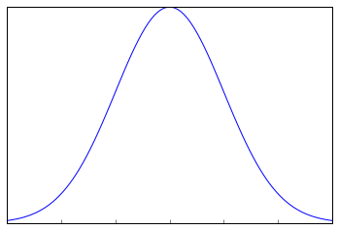

Principle of Hypothesis Testing
Test statistic: A quantity calculated from the sample(s) based on which hypothesis is written
Principle: Distribution of the test statistic is known under certain conditions and is used to validate the hypothesis
Based on where sample falls on the distribution of test statistic, the hypothesis is accepted or rejected
Sample mean very far from population mean could imply one of the following:
Sample does not belong to the same population
Population mean is different from what is assumed in the hypothesis
Sampling distribution of means
Sample 1
mean
Sample 3
mean
Sample 2
mean
Population mean
$$\overline{x}$$
Tails of the distribution

Slide 5
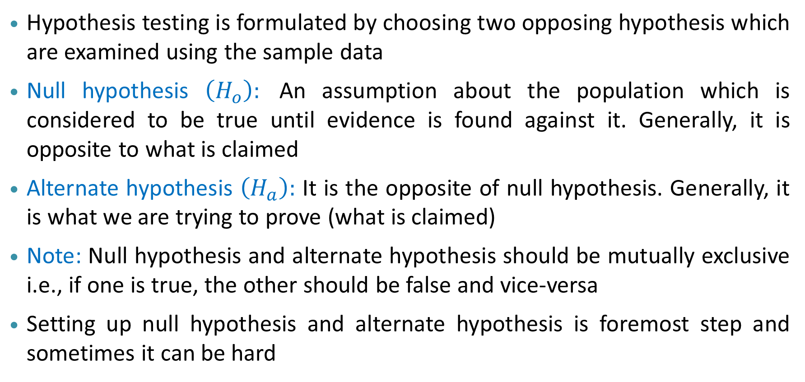
Hypothesis Testing – Formulation
Hypothesis testing is formulated by choosing two opposing hypothesis which are examined using the sample data
Null hypothesis $\left(H_{o}\right):$ An assumption about the population which is considered to be true until evidence is found against it. Generally, it is opposite to what is claimed
Alternate hypothesis $\left(H_{a}\right):$ It is the opposite of null hypothesis. Generally, it is what we are trying to prove (what is claimed)
Note: Null hypothesis and alternate hypothesis should be mutually exclusive i.e., if one is true, the other should be false and vice-versa
Setting up null hypothesis and alternate hypothesis is foremost step and sometimes it can be hard

Slide 6
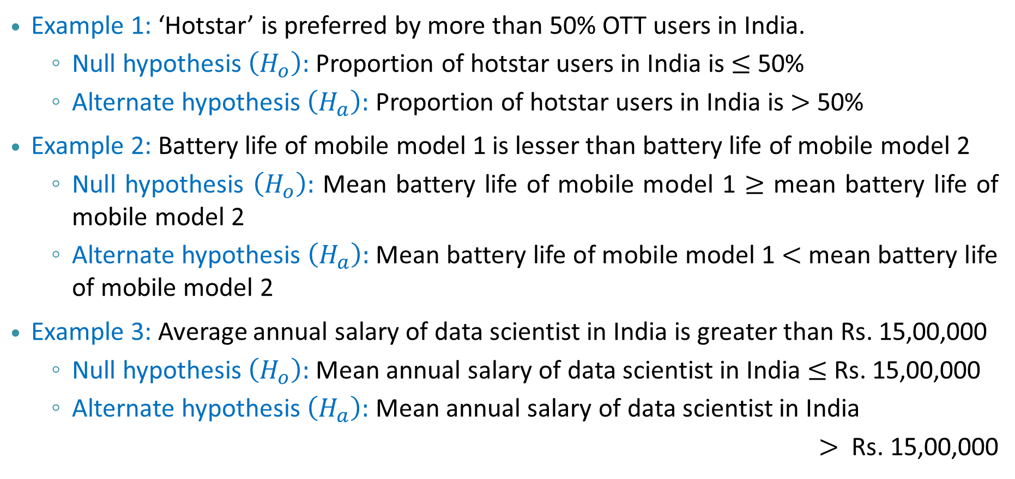
Null and Alternate Hypotheses – Examples
Example 1: ‘Hotstar’ is preferred by more than 50% OTT users in India.
Null hypothesis $\left(H_{o}\right):$ Proportion of hotstar users in India is $≤$ 50%
Alternate hypothesis $\left(H_{a}\right):$ Proportion of hotstar users in India is $>$ 50%
Example 2: Battery life of mobile model 1 is lesser than battery life of mobile model 2
Null hypothesis $\left(H_{o}\right):$ Mean battery life of mobile model 1 $≥$ mean battery life of mobile model 2
Alternate hypothesis $\left(H_{a}\right):$ Mean battery life of mobile model 1 $<$ mean battery life of mobile model 2
Example 3: Average annual salary of data scientist in India is greater than Rs. 15,00,000
Null hypothesis $\left(H_{o}\right):$ Mean annual salary of data scientist in India $≤$ Rs. 15,00,000
Alternate hypothesis $\left(H_{a}\right):$ Mean annual salary of data scientist in India
$>$ Rs. 15,00,000

Slide 7
Hypothesis Testing – Outcomes
Two outcomes of hypothesis testing:
Null hypothesis is rejected in favour of alternate hypothesis i.e., alternate hypothesis is accepted i.e., whatever we claim is acceptable
Failed to reject the null hypothesis i.e., alternate hypothesis cannot be accepted
Points to note:
1st outcome is when there is enough evidence from the sample to reject null hypothesis
2nd outcome is when there is not enough evidence to reject the null hypothesis
2nd outcome does not mean there is evidence to accept the null hypothesis
However, if a decision is required under 2nd outcome, then null hypothesis can be assumed to be true (status quo)

Slide 8
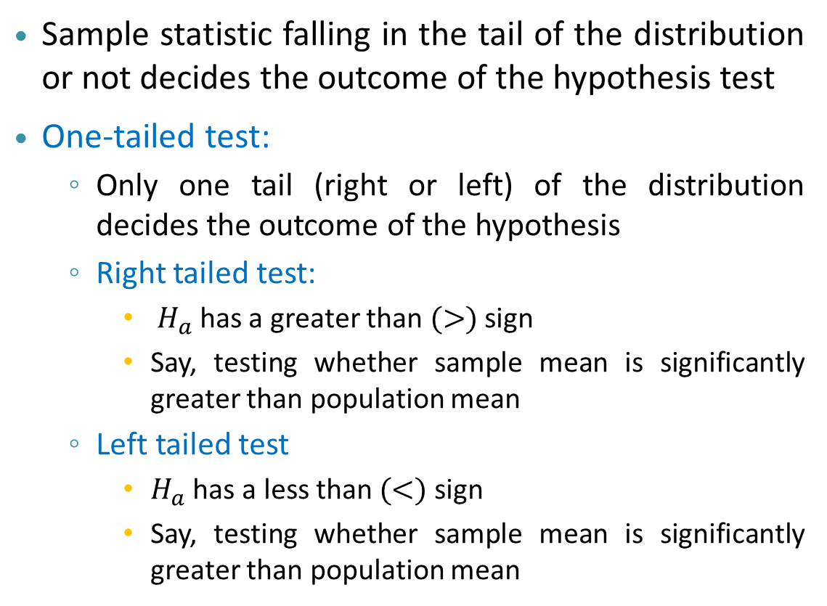

Hypothesis Testing: One tailed Vs Two tailed Test
Sample statistic falling in the tail of the distribution or not decides the outcome of the hypothesis test
One-tailed test:
Only one tail (right or left) of the distribution decides the outcome of the hypothesis
Right tailed test:
$H_{a}$ has a greater than $(>)$ sign
Say, testing whether sample mean is significantly greater than population mean
Left tailed test
$H_{a}$ has a less than $(<)$ sign
Say, testing whether sample mean is significantly greater than population mean
Sampling distribution of means
Sample
mean
Population mean
$$\overline{x}$$
Rejection region in right tail

Slide 9

Hypothesis Testing: One tailed Vs Two tailed Test
Sample statistic falling in the tail of the distribution or not decides the outcome of the hypothesis test
One-tailed test:
Only one tail (right or left) of the distribution decides the outcome of the hypothesis
Right tailed test:
$H_{a}$ has a greater than $(>)$ sign
Say, testing whether sample mean is significantly greater than population mean
Left tailed test
$H_{a}$ has a less than $(<)$ sign
Say, testing whether sample mean is significantly lesser than population mean
Sampling distribution of means
Sample
mean
Population mean
$$\overline{x}$$
Rejection region in left tail

Slide 10
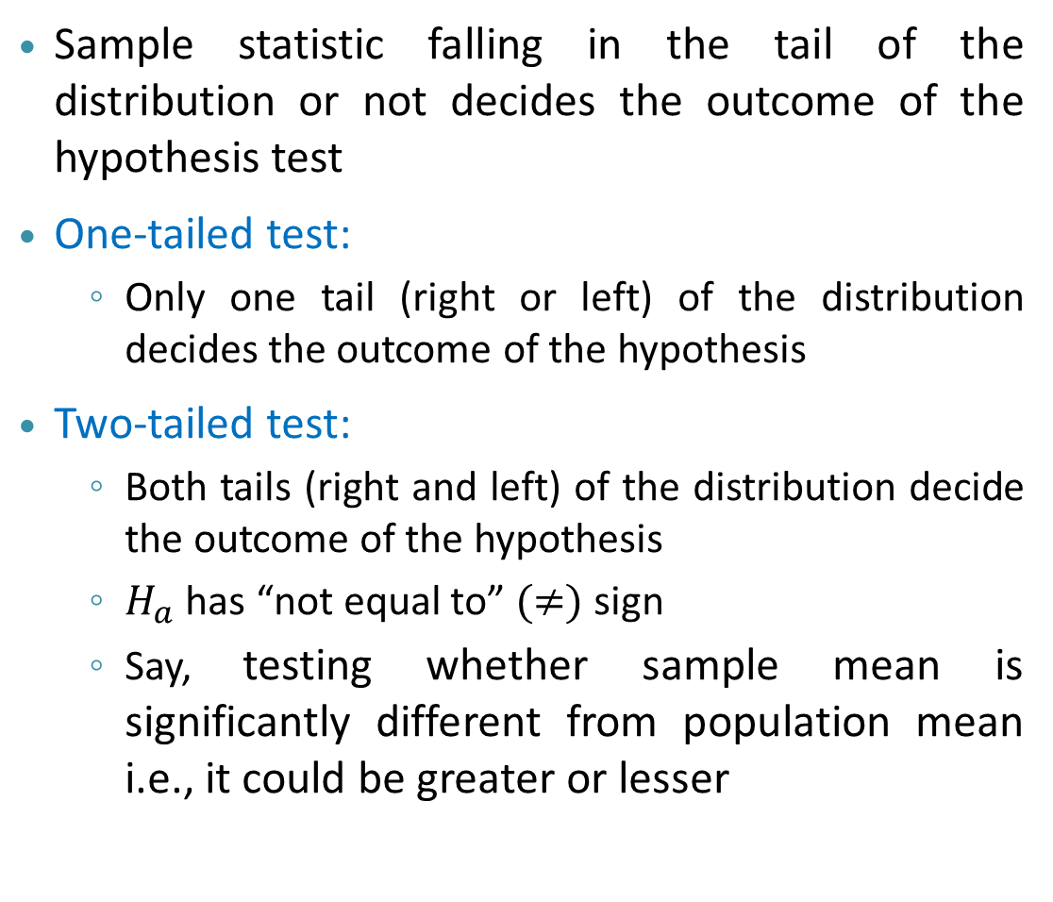

Hypothesis Testing: One tailed Vs Two tailed Test
Sample statistic falling in the tail of the distribution or not decides the outcome of the hypothesis test
One-tailed test:
Only one tail (right or left) of the distribution decides the outcome of the hypothesis
Two-tailed test:
Both tails (right and left) of the distribution decide the outcome of the hypothesis
$H_{a}$ has “not equal to” $(≠)$ sign
Say, testing whether sample mean is significantly different from population mean i.e., it could be greater or lesser
Sampling distribution of means
Sample 3
mean
Sample 2
mean
Population mean
$$\overline{x}$$
Rejection regions in both
tails of the distribution

Slide 11
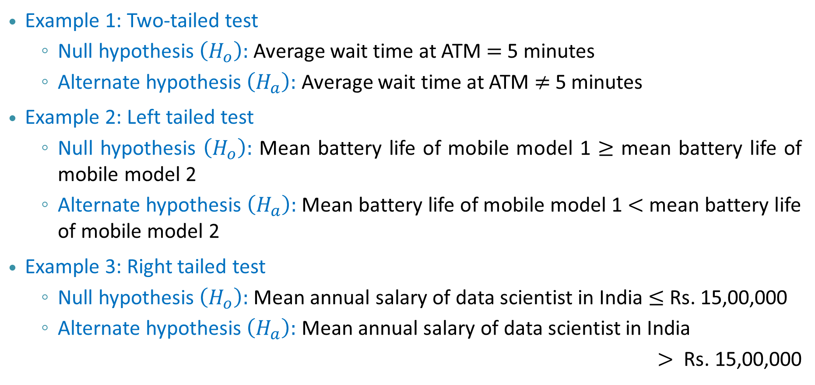
One Tailed and Two Tailed Tests – Examples
Example 1: Two-tailed test
Null hypothesis $\left(H_{o}\right):$ Average wait time at ATM $=$ 5 minutes
Alternate hypothesis $\left(H_{a}\right):$ Average wait time at ATM $≠$ 5 minutes
Example 2: Left tailed test
Null hypothesis $\left(H_{o}\right):$ Mean battery life of mobile model 1 $≥$ mean battery life of mobile model 2
Alternate hypothesis $\left(H_{a}\right):$ Mean battery life of mobile model 1 $<$ mean battery life of mobile model 2
Example 3: Right tailed test
Null hypothesis $\left(H_{o}\right):$ Mean annual salary of data scientist in India $≤$ Rs. 15,00,000
Alternate hypothesis $\left(H_{a}\right):$ Mean annual salary of data scientist in India
$>$ Rs. 15,00,000

Slide 12

Hypothesis Testing: Two Approaches
Question: How to determine the (or quantify) the tails of the distribution?
Two approaches exist in determining the tail and therefore, the outcome of a hypothesis test:
Critical value approach
A critical value for test statistic is fixed
Acts as a threshold to determine whether the test statistic falls in the tail or not
Two-tailed test will have two critical values
One-tailed test will have one critical value
Distribution of test statistic
$$\overline{x}$$
Rejection
region
Rejection
region
Critical values

Slide 13

Hypothesis Testing: Two Approaches
Question: How to determine the (or quantify) the tails of the distribution?
Two approaches exist in determining the tail and therefore, the outcome of a hypothesis test:
Critical value approach
p-value approach
P-value is probability of obtaining the test statistic under the assumption that null hypothesis is true
When p-value is lower than a threshold, the test statistic is considered to fall in the tail
Distribution of test statistic
$$\overline{x}$$
Rejection
region
Rejection
region
P-value threshold

Slide 14

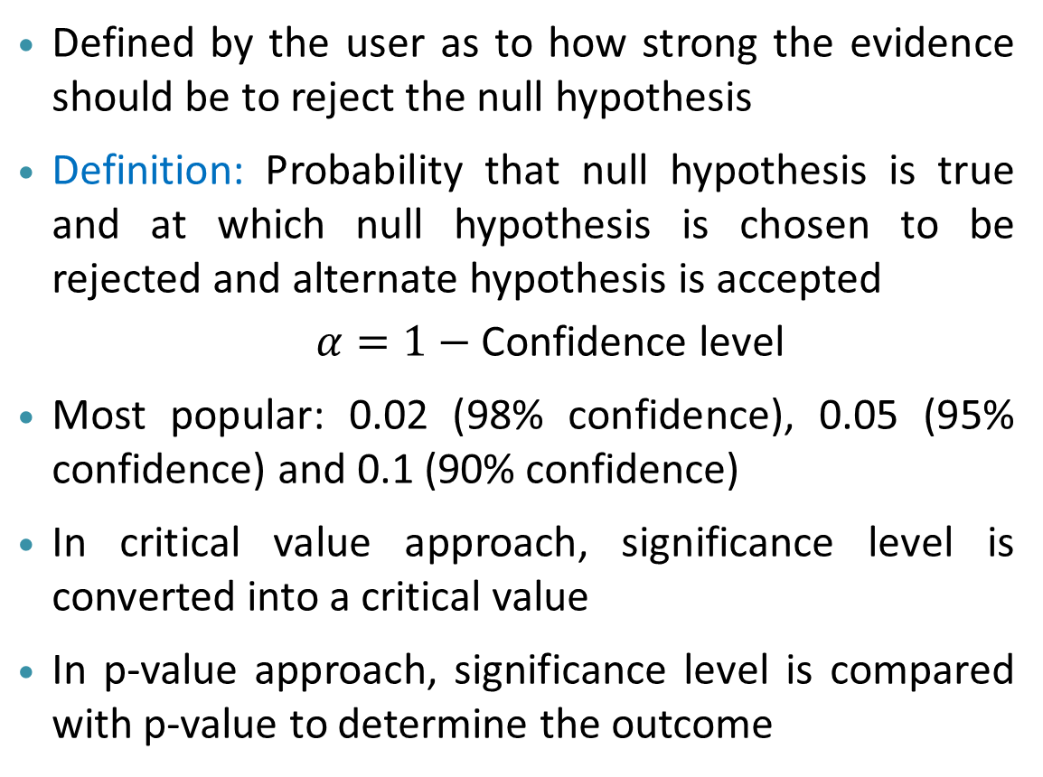






Hypothesis Testing: Significance Level $(α)$
Defined by the user as to how strong the evidence should be to reject the null hypothesis
Definition: Probability that null hypothesis is true and at which null hypothesis is chosen to be rejected and alternate hypothesis is accepted
$α=1−$ Confidence level
Most popular: 0.02 (98% confidence), 0.05 (95% confidence) and 0.1 (90% confidence)
In critical value approach, significance level is converted into a critical value
In p-value approach, significance level is compared with p-value to determine the outcome
Distribution of test statistic
Two-tailed
test
$$1−α$$
$$\frac{α}{2}$$
$$\overline{x}$$
Distribution of test statistic
One-tailed
test
$$1−α$$
$$α$$
$$\overline{x}$$

Slide 15
Hypothesis Testing: Summary of Steps
Step 1: State null and alternate hypothesis based on claim: Two-tailed or one-tailed test
Step 2: Decide level of significance $(α)$ based on how strong an evidence is required
Step 2: Decide level of significance (𝛼) based on how strong an evidence is required
Step 3: Identify the test statistic to be used and compute it
Step 4: Compute the critical value or p-value based on test statistic or $α$
Step 4: Compute the critical value or p-value based on test statistic or 𝛼
Step 5: Formulate a decision criteria and decide the outcome
Outcome 1: Reject null hypothesis and accept alternate – Accept $H_{a}$ Outcome 2: Fail to reject null hypothesis – Can accept $H_{o}$
Outcome 1: Reject null hypothesis and accept alternate – Accept 𝐻_𝑎 Outcome 2: Fail to reject null hypothesis – Can accept 𝐻_𝑜

Slide 16
Various Hypothesis Tests

Slide 17
Various Hypothesis Tests
Based on the population parameter and type of data, different types of hypothesis test are performed to reject or accept a claim
Types of hypothesis tests:
Z-test
t-test
Chi-squared test
Each of the above tests defines a test statistic based on the mean, proportion, etc. of the sample
Hypothesis test | Test statistic
Z-test | Z-statistic
t-test | T-statistic
Chi-squared test | Chi-squared statistic

Slide 18
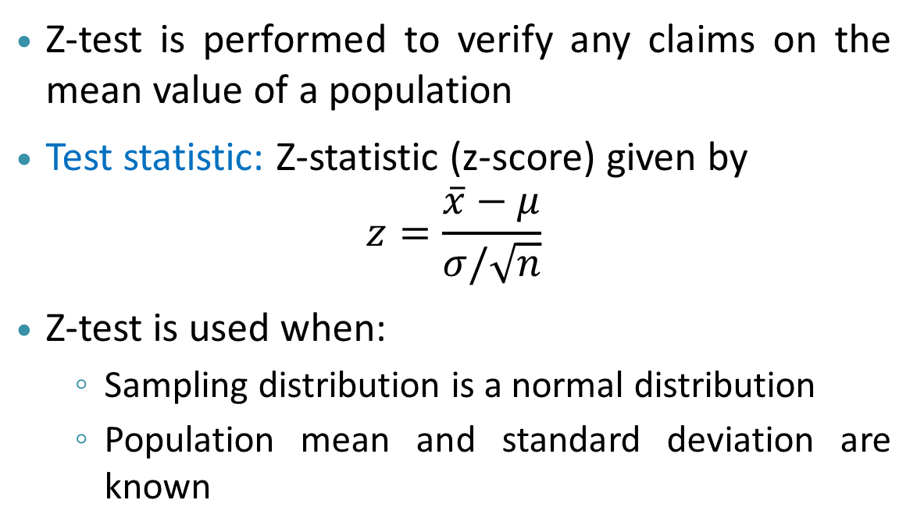


Z-test
Z-test is performed to verify any claims on the mean value of a population
Test statistic: Z-statistic (z-score) given by
$$z=\frac{\overline{x}−μ}{σ/\sqrt{n}}$$
Z-test is used when:
Sampling distribution is a normal distribution
Population mean and standard deviation are known
$$μ$$
z-score is
negative
z-score is
positive
$$\overline{x}$$

Slide 19

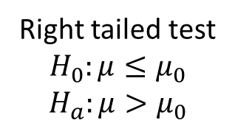
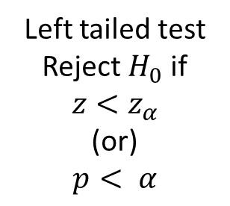
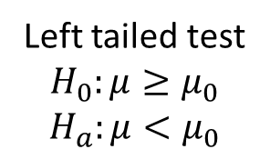


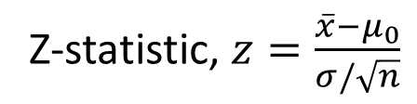

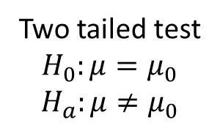
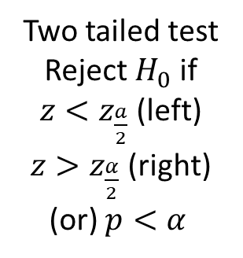
Z-test: Steps to be Followed
Step 4: Compute the z-critical value (or) p-value
Step 1: State null and alternate hypothesis
Z-critical value ($z_{α}$) from $α$ (tail dependent)
Right tail: $z_{ α};z_{α/2}$ is positive
Left tail: $z_{ α};z_{α/2}$ is negative
Left tailed test
$H_{0}:μ≥μ_{0}$
$H_{a}:μ<μ_{0}$
Right tailed test
$H_{0}:μ≤μ_{0}$
$H_{a}:μ>μ_{0}$
Two tailed test
$H_{0}:μ=μ_{0}$
$H_{a}:μ≠μ_{0}$
p-value computed from $z$
Step 2: Decide a significance level
$$α=0.02 or 0.05 or 0.1$$
Step 5: Decision criteria
Two tailed test
Reject $H_{0}$ if
$z<z_{\frac{a}{2}}$ (left)
$z>z_{\frac{α}{2}}$ (right)
(or) $p<α$
Left tailed test
Reject $H_{0}$ if
$$z<z_{α}$$
(or)
$$p< α$$
Right tailed test
Reject $H_{0}$ if
$$z>z_{α}$$
(or)
$$p< α$$
Step 3: Compute the test statistic
Z-statistic, $z=\frac{\overline{x}−μ_{0}}{σ/\sqrt{n}}$

Slide 20
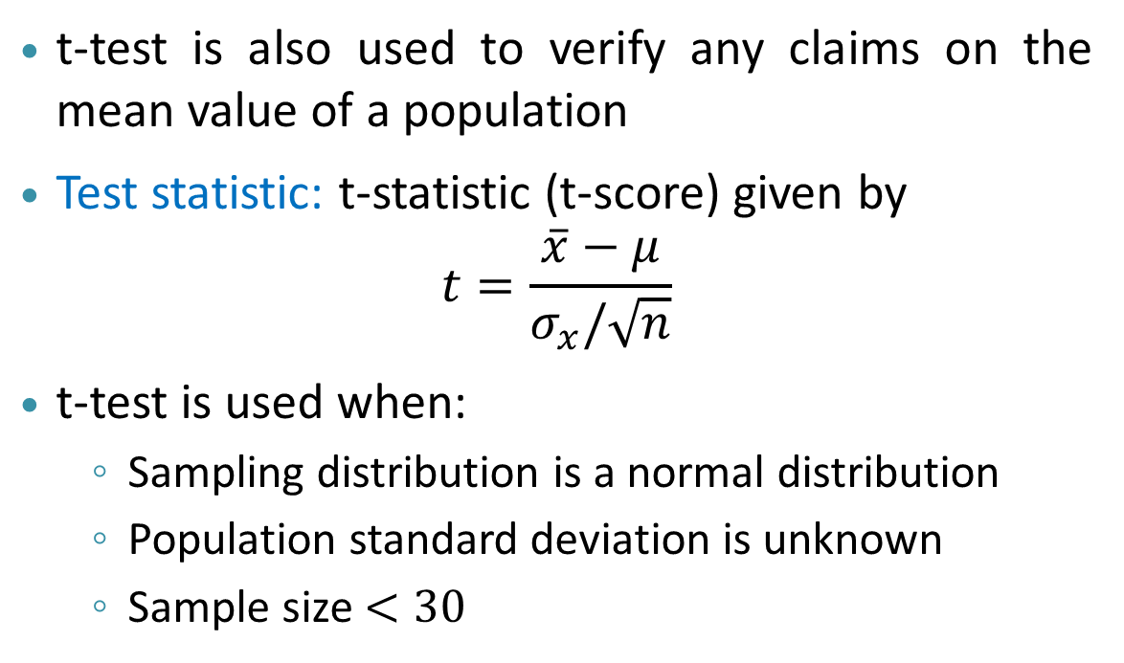
t-test
t-test is also used to verify any claims on the mean value of a population
Test statistic: t-statistic (t-score) given by
$$t=\frac{\overline{x}−μ}{σ_{x}/\sqrt{n}}$$
t-test is used when:
Sampling distribution is a normal distribution
Population standard deviation is unknown
Sample size $<30$
$$μ$$
t-score is
negative
t-score is
positive
$$\overline{x}$$

Slide 21

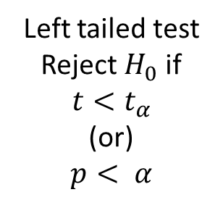

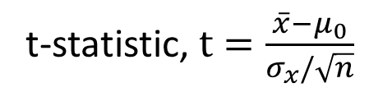
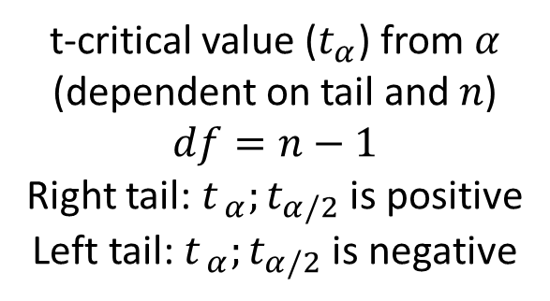
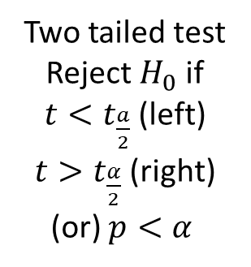
t-test: Steps to be Followed
Step 4: Compute the t-critical value (or) p-value
Step 1: State null and alternate hypothesis
t-critical value ($t_{α}$) from $α$ (dependent on tail and $n$)
$$df=n−1$$
Right tail: $t_{ α};t_{α/2}$ is positive
Left tail: $t_{ α};t_{α/2}$ is negative
Left tailed test
$H_{0}:μ≥μ_{0}$
$H_{a}:μ<μ_{0}$
Right tailed test
$H_{0}:μ≤μ_{0}$
$H_{a}:μ>μ_{0}$
Two tailed test
$H_{0}:μ=μ_{0}$
$H_{a}:μ≠μ_{0}$
p-value computed from $t$
Step 2: Decide a significance level
$$α=0.02 or 0.05 or 0.1$$
Step 5: Decision criteria
Two tailed test
Reject $H_{0}$ if
$t<t_{\frac{a}{2}}$ (left)
$t>t_{\frac{α}{2}}$ (right)
(or) $p<α$
Left tailed test
Reject $H_{0}$ if
$$t<t_{α}$$
(or)
$$p< α$$
Right tailed test
Reject $H_{0}$ if
$$t>t_{α}$$
(or)
$$p< α$$
Step 3: Compute the test statistic
t-statistic, $t=\frac{\overline{x}−μ_{0}}{σ_{x}/\sqrt{n}}$

Slide 22
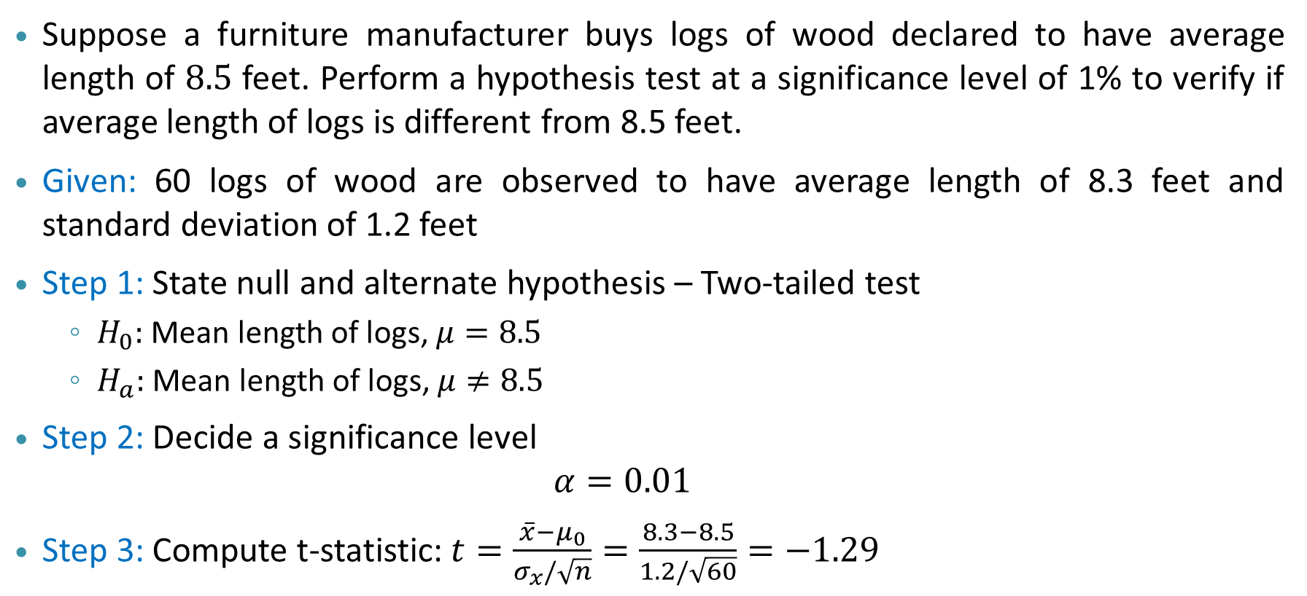
Example:
Suppose a furniture manufacturer buys logs of wood declared to have average length of $8.5$ feet. Perform a hypothesis test at a significance level of 1% to verify if average length of logs is different from 8.5 feet.
Given: 60 logs of wood are observed to have average length of 8.3 feet and standard deviation of 1.2 feet
Step 1: State null and alternate hypothesis – Two-tailed test
$H_{0}:$ Mean length of logs, $μ=8.5$
$H_{a}:$ Mean length of logs, $μ≠8.5$
Step 2: Decide a significance level
$$α=0.01$$
Step 3: Compute t-statistic: $t=\frac{\overline{x}−μ_{0}}{σ_{x}/\sqrt{n}}=\frac{8.3−8.5}{1.2/\sqrt{60}}=−1.29$

Slide 23
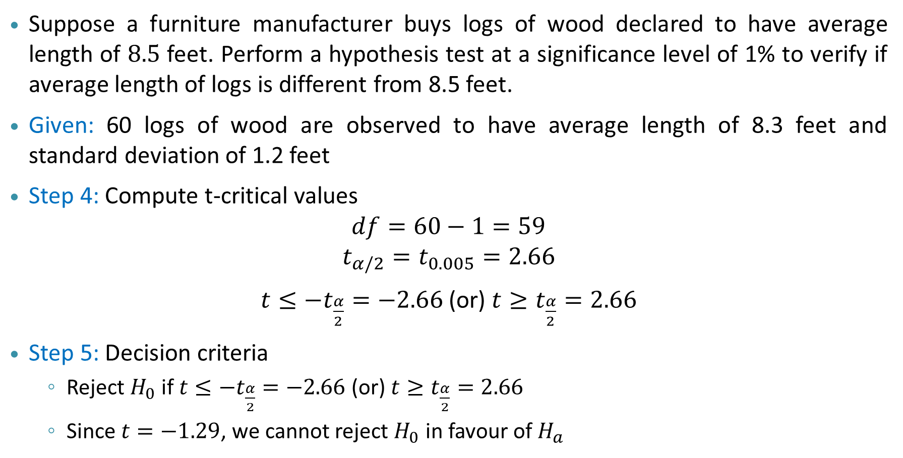
Example:
Suppose a furniture manufacturer buys logs of wood declared to have average length of $8.5$ feet. Perform a hypothesis test at a significance level of 1% to verify if average length of logs is different from 8.5 feet.
Given: 60 logs of wood are observed to have average length of 8.3 feet and standard deviation of 1.2 feet
Step 4: Compute t-critical values
$$df=60−1=59$$
$$t_{α/2}=t_{0.005}=2.66$$
$t≤−t_{\frac{α}{2}}=−2.66$ (or) $t≥t_{\frac{α}{2}}=2.66$
Step 5: Decision criteria
Reject $H_{0}$ if $t≤−t_{\frac{α}{2}}=−2.66$ (or) $t≥t_{\frac{α}{2}}=2.66$
Since $t=−1.29$, we cannot reject $H_{0}$ in favour of $H_{a}$

Slide 24
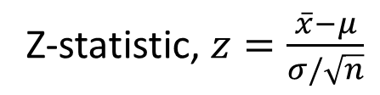
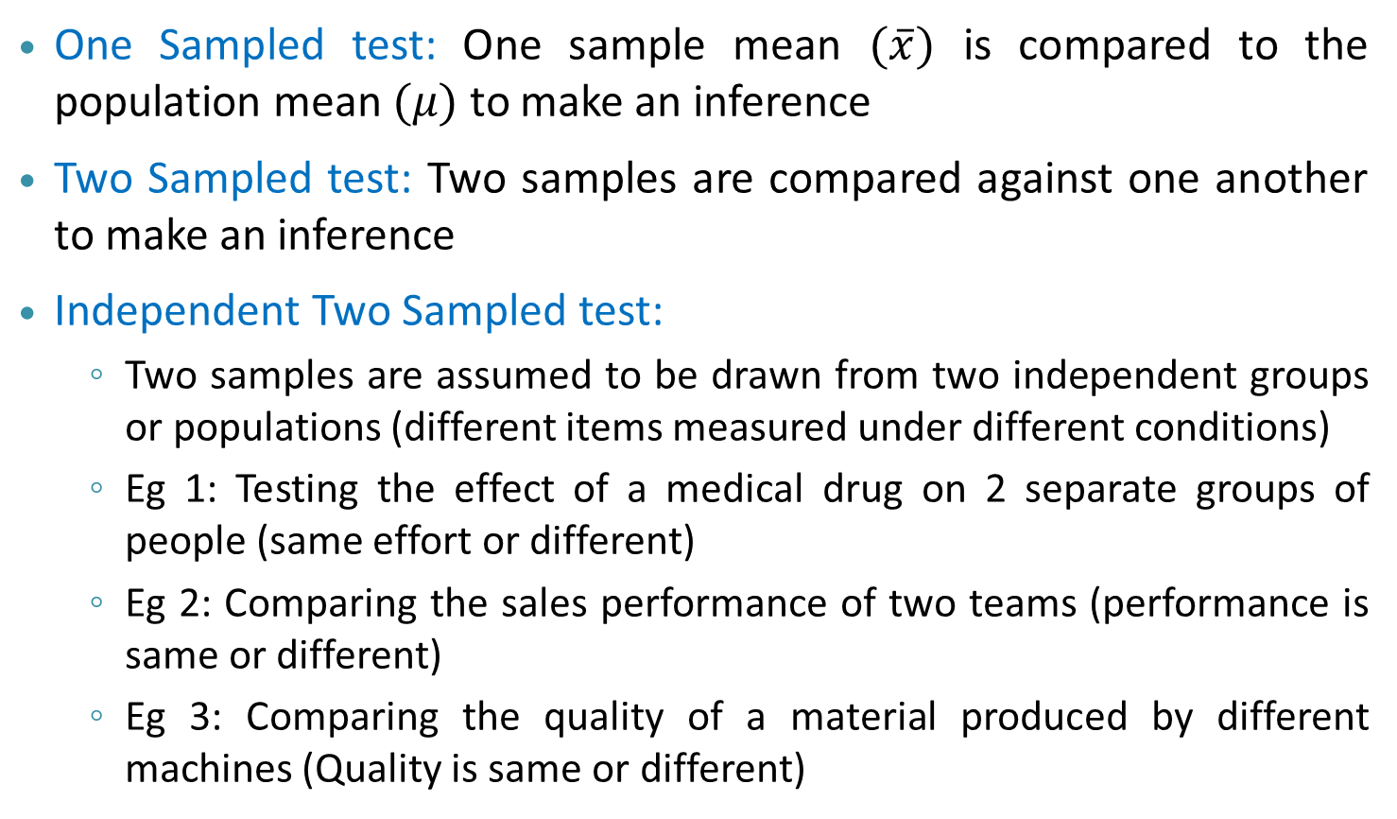
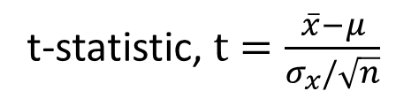
One Sampled Vs Two Sampled Z-test and t-test
One Sampled test: One sample mean $(\overline{x})$ is compared to the population mean $(μ)$ to make an inference
Two Sampled test: Two samples are compared against one another to make an inference
Independent Two Sampled test:
Two samples are assumed to be drawn from two independent groups or populations (different items measured under different conditions)
Eg 1: Testing the effect of a medical drug on 2 separate groups of people (same effort or different)
Eg 2: Comparing the sales performance of two teams (performance is same or different)
Eg 3: Comparing the quality of a material produced by different machines (Quality is same or different)
Z-statistic, $z=\frac{\overline{x}−μ}{σ/\sqrt{n}}$
t-statistic, $t=\frac{\overline{x}−μ}{σ_{x}/\sqrt{n}}$

Slide 25
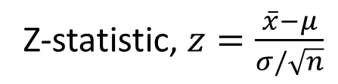
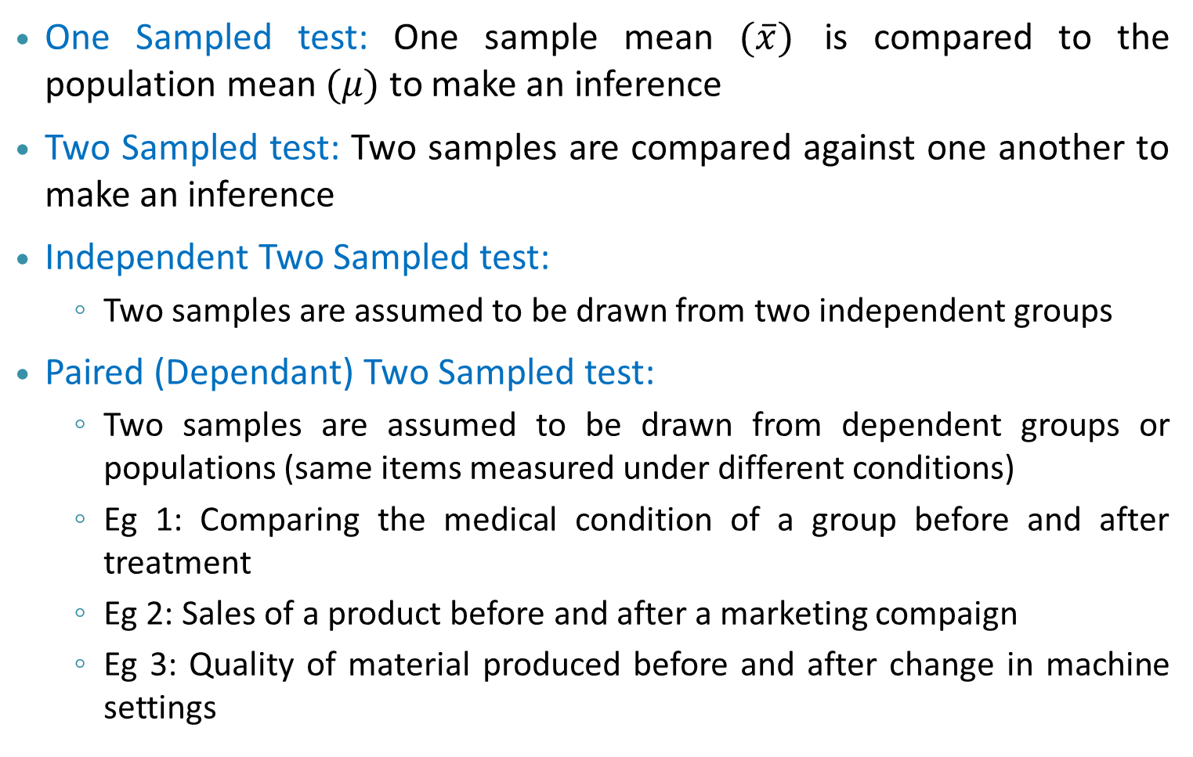
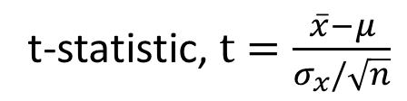
One Sampled Vs Two Sampled Z-test and t-test
One Sampled test: One sample mean $(\overline{x})$ is compared to the population mean $(μ)$ to make an inference
Two Sampled test: Two samples are compared against one another to make an inference
Independent Two Sampled test:
Two samples are assumed to be drawn from two independent groups
Paired (Dependant) Two Sampled test:
Two samples are assumed to be drawn from dependent groups or populations (same items measured under different conditions)
Eg 1: Comparing the medical condition of a group before and after treatment
Eg 2: Sales of a product before and after a marketing compaign
Eg 3: Quality of material produced before and after change in machine settings
Z-statistic, $z=\frac{\overline{x}−μ}{σ/\sqrt{n}}$
t-statistic, $t=\frac{\overline{x}−μ}{σ_{x}/\sqrt{n}}$

Slide 26
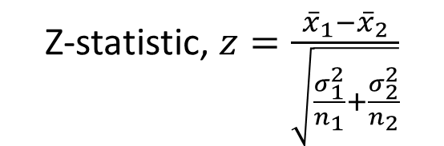
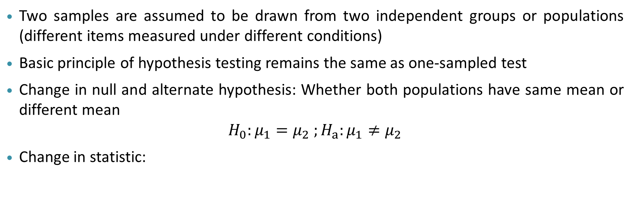
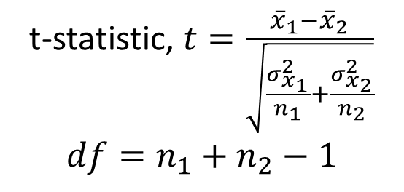
Independent Two Sampled test:
Two samples are assumed to be drawn from two independent groups or populations (different items measured under different conditions)
Basic principle of hypothesis testing remains the same as one-sampled test
Change in null and alternate hypothesis: Whether both populations have same mean or different mean
$$H_{0}:μ_{1}=μ_{2} ;H_{a}:μ_{1}≠μ_{2}$$
Change in statistic:
Z-statistic, $z=\frac{{\overline{x}}_{1}−{\overline{x}}_{2}}{\sqrt{\frac{σ_{1}^{2}}{n_{1}}+\frac{σ_{2}^{2}}{n_{2}}}}$
t-statistic, $t=\frac{{\overline{x}}_{1}−{\overline{x}}_{2}}{\sqrt{\frac{σ_{x_{1}}^{2}}{n_{1}}+\frac{σ_{x_{2}}^{2}}{n_{2}}}}$
$$df=n_{1}+n_{2}−1$$

Slide 27
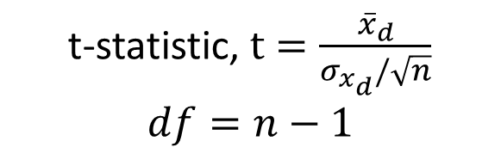
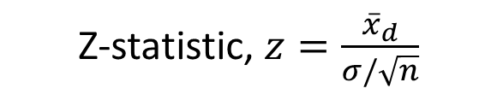
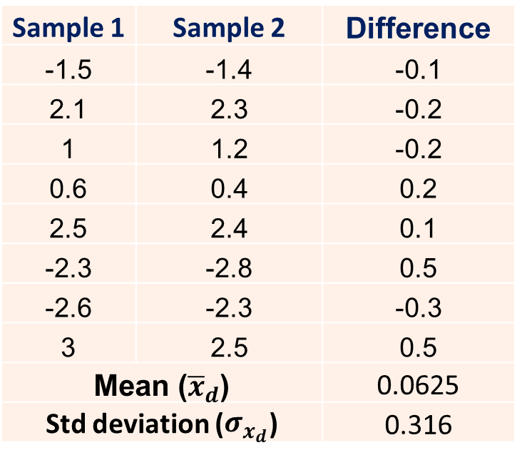
Paired Sampled test:
Two samples are assumed to be drawn from dependent groups or populations
Paired sampled test is exactly same as one-sample tested performed on the difference between the paired samples
Sample 1 | Sample 2 | Difference
-1.5 | -1.4 | -0.1
2.1 | 2.3 | -0.2
1 | 1.2 | -0.2
0.6 | 0.4 | 0.2
2.5 | 2.4 | 0.1
-2.3 | -2.8 | 0.5
-2.6 | -2.3 | -0.3
3 | 2.5 | 0.5
Mean (${\overline{x}}_{d}$) | 7 | 0.0625
Std deviation ($σ_{x_{d}}$) |  | 0.316
Z-statistic, $z=\frac{{\overline{x}}_{d}}{σ/\sqrt{n}}$
t-statistic, $t=\frac{{\overline{x}}_{d}}{σ_{x_{d}}/\sqrt{n}}$
$$df=n−1$$
Note: All types of z-tests and t-tests can be applied on proportion of population as well

Slide 28
Chi-squared test
Used when categorical variables are to be compared
Two types of chi-squared test:
Goodness of fit test:
Determines if sample data of categorical variable matches with population or not
Eg: A large bunch of Chocolates of four different flavours are taken. Packed into many packets of 100 chocolates each. Can you confirm if the four flavours are of equal proportion in all the packets, given some packets as samples?

Slide 29
Chi-squared test
Used when categorical variables are to be compared
Two types of chi-squared test:
Goodness of fit test:
Determines if sample data of categorical variable matches with population or not
Test of independence:
Determines if two categorical variables are independent or related to one another
Eg: Does interest in a subject depend on gender or are they independent?
Contingency table
 | Science | Engineering | Art
Male (total=65) | 20 | 30 | 15
Female (total=65) | 20 | 15 | 30

Slide 30
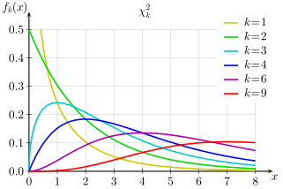
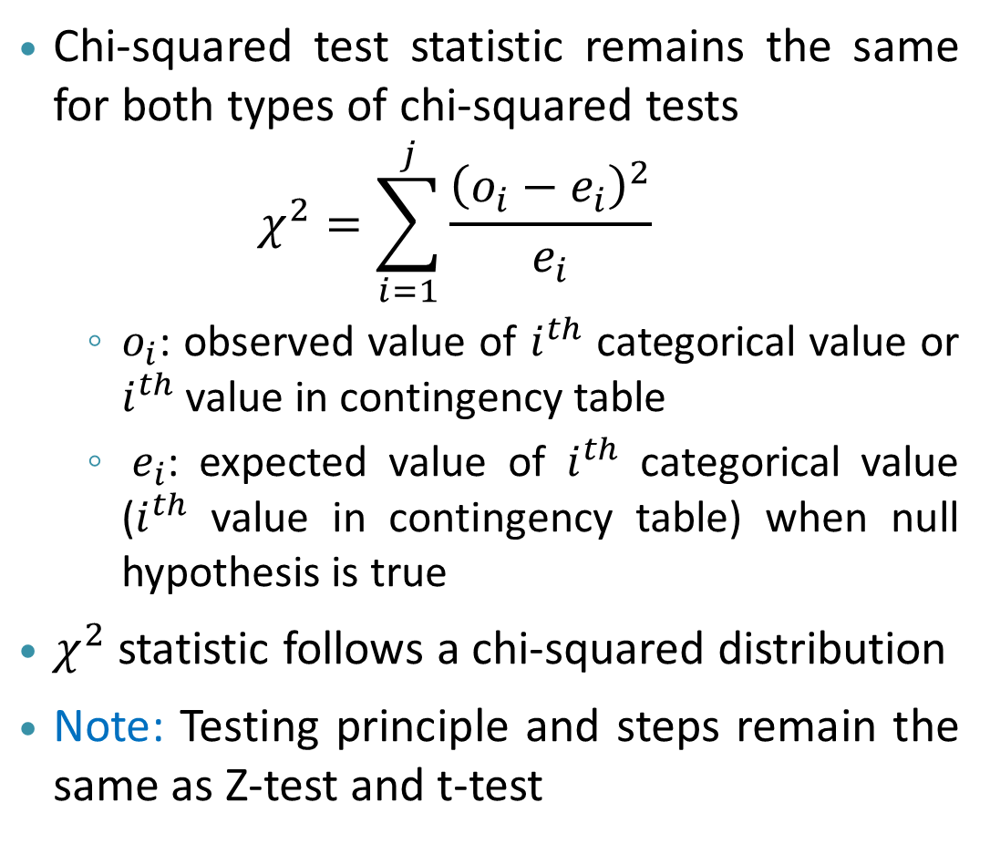
Chi-squared test statistic
Chi-squared test statistic remains the same for both types of chi-squared tests
$$χ^{2}=\sum_{i=1}^{j}{\frac{{\left(o_{i}−e_{i}\right)}^{2}}{e_{i}}}$$
$o_{i}$: observed value of $i^{th}$ categorical value or $i^{th}$ value in contingency table
$e_{i}$: expected value of $i^{th}$ categorical value ($i^{th}$ value in contingency table) when null hypothesis is true
$χ^{2}$ statistic follows a chi-squared distribution
Note: Testing principle and steps remain the same as Z-test and t-test
Chi-squared distribution
Degrees of freedom = (r-1)(c-1) in test
of independence
r = No. of rows in the contingency table
c = No. of columns in the contingency

Slide 31
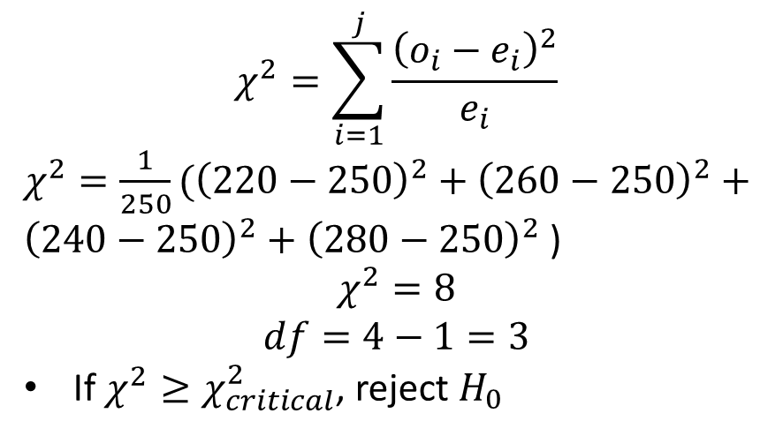
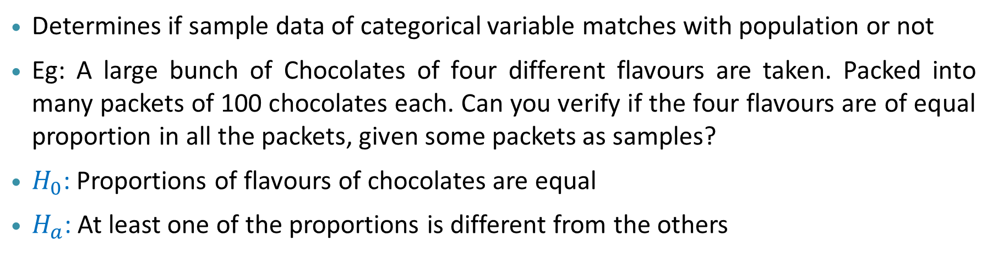
Chi-squared test: Goodness of fit test
Determines if sample data of categorical variable matches with population or not
Eg: A large bunch of Chocolates of four different flavours are taken. Packed into many packets of 100 chocolates each. Can you verify if the four flavours are of equal proportion in all the packets, given some packets as samples?
$H_{0}$: Proportions of flavours of chocolates are equal
$H_{a}$: At least one of the proportions is different from the others
Degrees of freedom = No of categories - 1
$$χ^{2}=\sum_{i=1}^{j}{\frac{{\left(o_{i}−e_{i}\right)}^{2}}{e_{i}}}$$
$χ^{2}={\frac{1}{250}(\left(220−250\right)}^{2}+{\left(260−250\right)}^{2}+{\left(240−250\right)}^{2}+{\left(280−250\right)}^{2}$)
$$χ^{2}=8$$
$$df=4−1=3$$
If $χ^{2}≥χ_{critical}^{2}$, reject $H_{0}$
Chocolate flavour | Observed number in 10 packets | Expected number
Apple | 220 | 250
Strawberry | 260 | 250
Orange | 240 | 250
Mango | 280 | 250

Slide 32
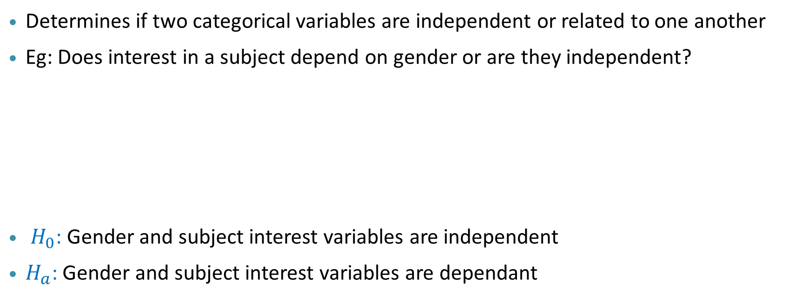
Chi-squared test: Test of independence
Determines if two categorical variables are independent or related to one another
Eg: Does interest in a subject depend on gender or are they independent?
$H_{0}$: Gender and subject interest variables are independent
$H_{a}$: Gender and subject interest variables are dependant
Contingency table
 | Science | Engineering | Art
Male (total=65) | 20 | 30 | 15
Female (total=65) | 20 | 15 | 30
Degrees of freedom = (r-1)(c-1)
r = No. of rows in the contingency table
c = No. of columns in the contingency table

Slide 33
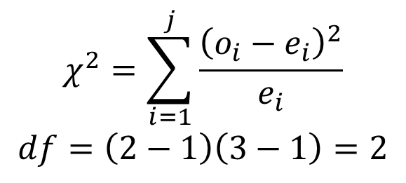
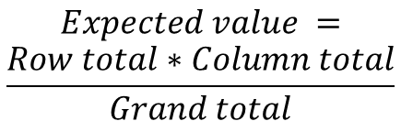
Chi-squared test: Test of independence
Determines if two categorical variables are independent or related to one another
Eg: Does interest in a subject depend on gender or are they independent?
Contingency table (observed values)
 | Science | Engineering | Art
Male (total=65) | 20 | 30 | 15
Female (total=65) | 20 | 15 | 30
Column totals | 40 | 45 | 45
$$Expected value =$$
$$\frac{Row total∗Column total}{Grand total}$$
Contingency table (expected values)
 | Science | Engineering | Art
Male | (40*65)/130 | (45*65)/130 | (45*65)/130
Female | (40*65)/130 | (45*65)/130 | (45*65)/130
$$χ^{2}=\sum_{i=1}^{j}{\frac{{\left(o_{i}−e_{i}\right)}^{2}}{e_{i}}}$$
$$df=\left(2−1\right)\left(3−1\right)=2$$

Slide 34
Types of Errors in Hypothesis Testing

Slide 35
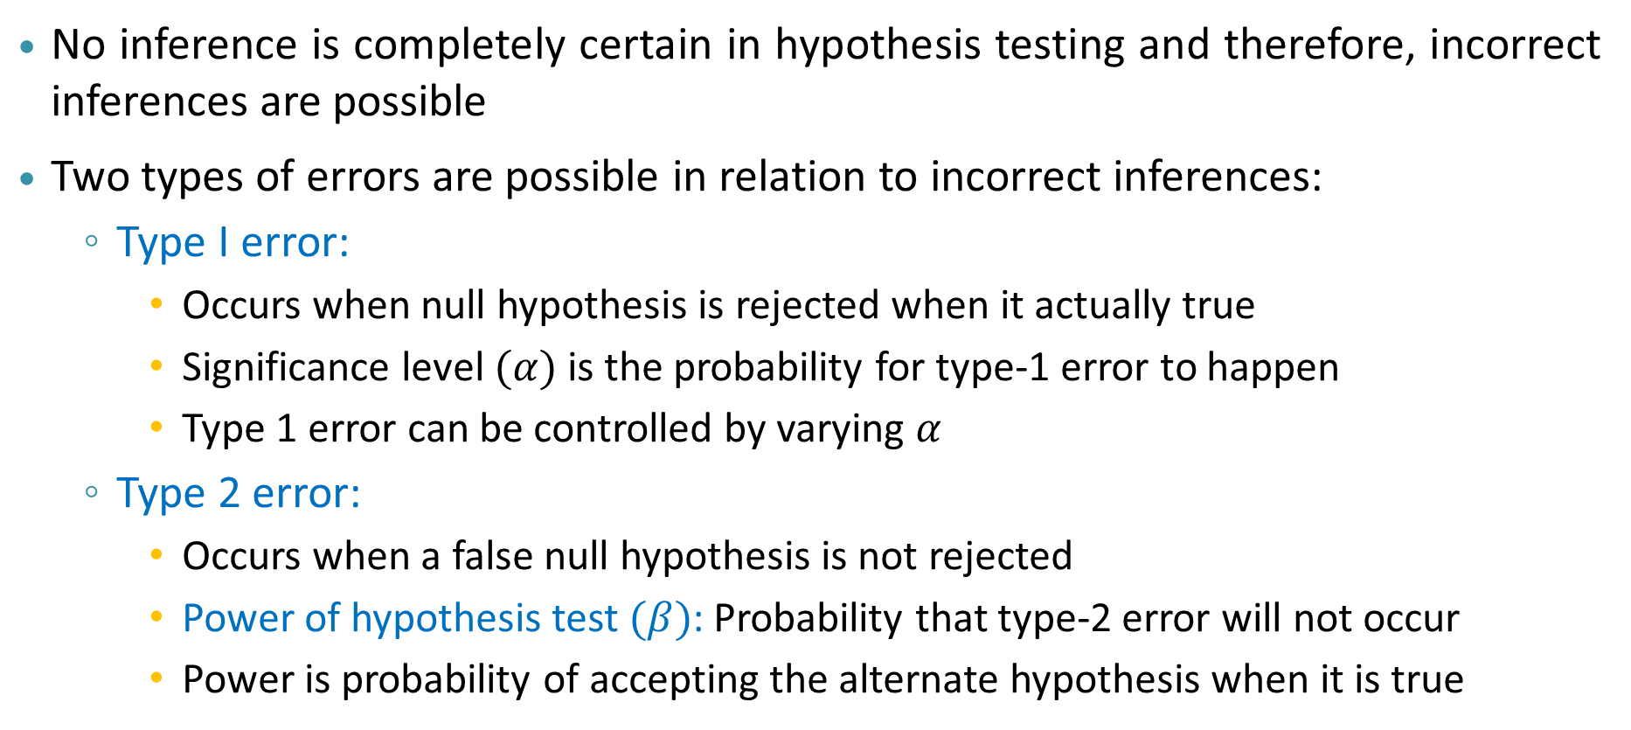
Types of Errors in Hypothesis Testing
No inference is completely certain in hypothesis testing and therefore, incorrect inferences are possible
Two types of errors are possible in relation to incorrect inferences:
Type I error:
Occurs when null hypothesis is rejected when it actually true
Significance level $(α)$ is the probability for type-1 error to happen
Type 1 error can be controlled by varying $α$
Type 2 error:
Occurs when a false null hypothesis is not rejected
Power of hypothesis test $(β)$: Probability that type-2 error will not occur
Power is probability of accepting the alternate hypothesis when it is true

Slide 36
Summary
Hypothesis testing is about verifying claims made on the population using sample data
Works on the principle that sample statistic follows a known distribution
Formulated as two opposing statements: null and alternate hypothesis
Outcome could be rejection of null hypothesis or failure to reject null hypothesis at a chosen level of significance
Different types of tests exist based on the type of variable and type of claim
Two types of error (Type-1 and Type-2) could occur in relation to the outcomes of a hypothesis test
Errors could be controlled by varying significance level and sample size

Slide 37

THANK YOU

